Slide 1





STRATEGIC SITES INVENTORY
(SSI) PROGRAM DAY

Slide 2

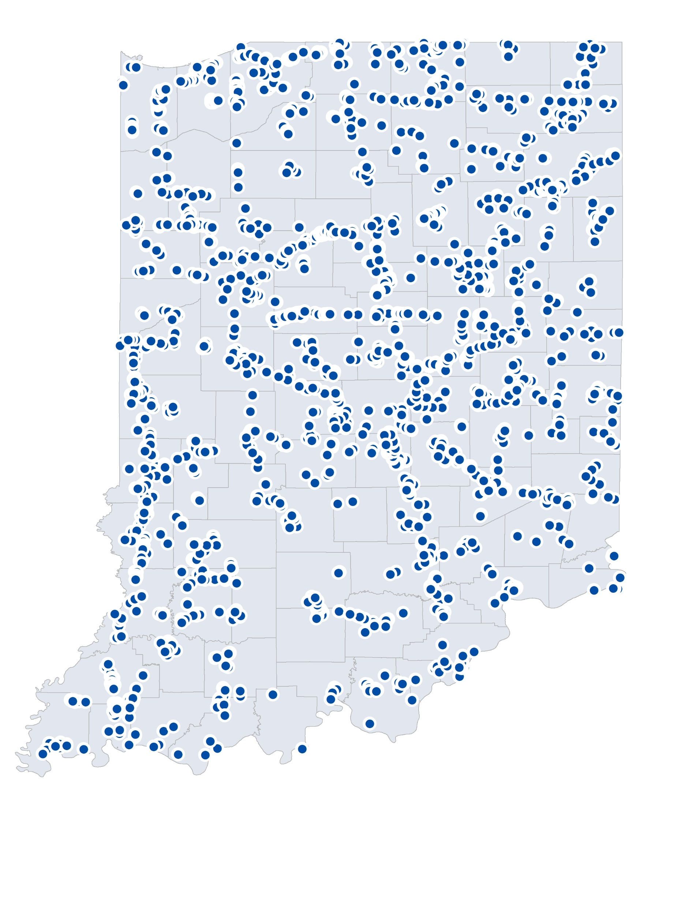

PHASE 1 IDENTIFICATION
92
counties
searched
1,724+
sites
identified
Site Discovery Project Land Uses
  Megasite
  Heavy Industrial
  Light Industrial
  Heavy Agribusiness
  General Agribusiness

Slide 3
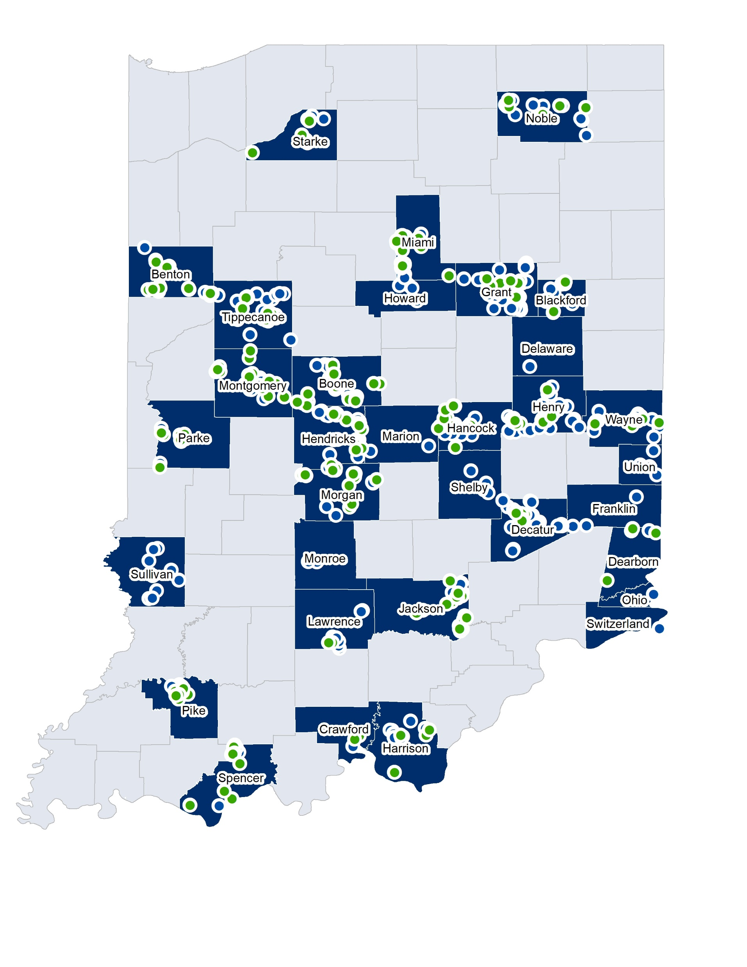

LOCAL SITE REVIEW WORKSHOPS
Next Level Business
23
counties
completed
495
sites
reviewed
235
sites
ranked 4.0-5.0

Slide 4

SPECIAL THANKS TO OUR SPONSOR

